Slide 1
PUT CALL Parity & GREEKS
Neha Mishra

Slide 2
PUT CALL Parity
Relationship between the price of European put options and European call options of the same class.
Put-call parity applies only to European options, and not American options.
FYI
The put/call parity concept was introduced by economist Hans R. Stoll in his Dec. 1969 paper "The Relationship Between Put and Call Option Prices," published in The Journal of Finance.

Slide 3

FYI
The equation expressing put-call parity is:
C + PV(x) = P + S
where:
C = price of the European call option
PV(x) = the present value of the strike price (x), discounted from the value on the expiration date at the risk-free rate
P = price of the European put
S = spot price or the current market value of the underlying asset
X= Strike Price of call and put
r= annual interest rate t= time in years

Slide 4
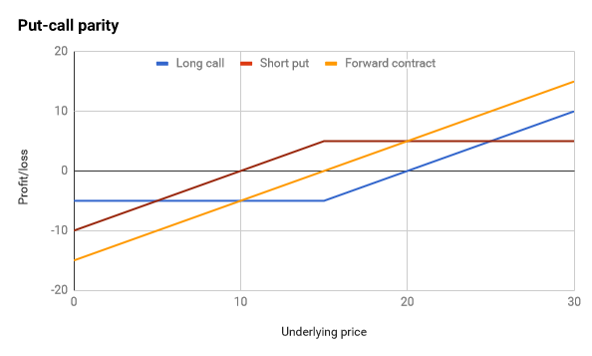
Let's say that the risk-free rate is 4% and that AAPL.OQ stock is currently trading at $10. For AAPL.OQ options expiring in one year with a strike price of $15, and purchasing the call costs you $5.

Slide 5
Put/call parity says the price of a call option implies a certain fair price for the corresponding put option with the same strike price and expiration (and vice versa).
Also, arbitrage opportunities would materialize if there is a divergence between the value of calls and puts, enabling some traders to earn a risk-free profit until the put call parity is restored.
Consider, for whatever reason, the puts are trading at $12, the calls at $7.
When one side of the put-call parity equation is greater than the other, this represents an arbitrage opportunity. You can "sell" the more expensive side of the equation and buy the cheaper side to make a risk free profit

Slide 6
GREEKS
"Greeks" is a term used in the options market to describe the different dimensions of risk involved in taking an options position.
The primary Greeks (Delta, Vega, Theta, Gamma, and Rho) are calculated each as a first partial derivative of the options pricing model.
Greeks encompass many variables. These include delta, theta, gamma, vega, and rho, among others. Each one of these variables/Greeks has a number associated with it, and that number tells traders about how the option moves or the risk associated with that option.
Greeks are used by options traders and portfolio managers to hedge risk and understand how their p&l will behave as prices move.

Slide 7
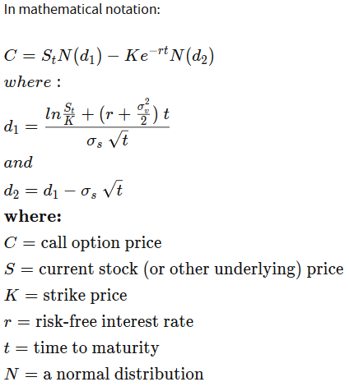

Slide 8
Delta (Δ) represents the rate of change between the option's price and a $1 change in the underlying asset's price.
price sensitivity of the option relative to the underlying
Delta of a call option has a range between zero and one, while the delta of a put option has a range between zero and negative one.
Delta=1 ------ Deep ITM = X<<S
Delta=0 ------ Deep OTM = S<<X
For example, assume an investor is long a call option with a delta of 0.50. Therefore, if the underlying stock increases by $1, the option's price would theoretically increase by 50 cents.

Slide 9
Theta (Θ) represents the rate of change between the option price and time. Theta indicates the amount an option's price would decrease as the time to expiration(tenor) decreases.
time sensitivity of the option relative to the underlying. sometimes known as an option's time decay
Theta increases when options are at-the-money, and decreases when options are in- and out-of-the money.
Options closer to expiration also have accelerating time decay. Long calls and long puts will usually have negative Theta; short calls and short puts will have positive Theta.
an instrument whose value is not eroded by time, such as a stock, would have zero Theta.
For example, assume an investor is long an option with a theta of -0.50. The option's price would decrease by 50 cents every day that passes, all else being equal. If three trading days pass, the option's value would theoretically decrease by $1.50.

Slide 10
Vega (v) represents the rate of change between an option's value and the underlying asset's implied volatility.
This is the option's sensitivity to volatility.
increased volatility implies that the underlying instrument is more likely to experience extreme values, a rise in volatility will correspondingly increase the value of an option. Conversely, a decrease in volatility will negatively affect the value of the option.
Vega is at its maximum for at-the-money options that have longer times until expiration.
For example, an option with a Vega of 0.10 indicates the option's value is expected to change by 10 cents if the implied volatility changes by 1%.

Slide 11
Rho (p) represents the rate of change between an option's value and a 1% change in the interest rate. This measures sensitivity to the interest rate.
Rho is greatest for at-the-money options with long times until expiration.
For example, assume a call option has a rho of 0.05 and a price of $1.25. If interest rates rise by 1%, the value of the call option would increase to $1.30, all else being equal.

Slide 12
Gamma (Γ) represents the rate of change between an option's delta and the underlying asset's price.
This is called second-order (second-derivative) price sensitivity.
Gamma indicates the amount the delta would change given a $1 move in the underlying security.
Gamma is used to determine how stable an option's delta is: higher gamma values indicate that delta could change dramatically in response to even small movements in the underlying's price.
For example, assume an investor is long one call option on hypothetical stock XYZ. The call option has a delta of 0.50 and a gamma of 0.10. Therefore, if stock XYZ increases or decreases by $1, the call option's delta would increase or decrease by 0.10.

Slide 13
Gamma is higher for options that are at-the-money and lower for options that are in- and out-of-the-money.
Gamma values are generally smaller the further away from the date of expiration; options with longer expirations are less sensitive to delta changes. As expiration approaches, gamma values are typically larger, as price changes have more impact on gamma.

Slide 14
Minor Greeks
Some other Greeks, are lambda, epsilon, vomma, vera, speed, zomma, color, ultima.
These Greeks are second- or third-derivatives of the pricing model and affect things such as the change in delta with a change in volatility and so on.

Slide 15
Options traders may opt to not only hedge delta but also gamma in order to be delta-gamma neutral, meaning that as the underlying price moves, the delta will remain close to zero.
Option hedging
For options traders, delta also represents the hedge ratio for creating a delta-neutral position. For example if you purchase a standard American call option with a 0.40 delta, you will need to sell 40 shares of stock to be fully hedged.

